Slide 1

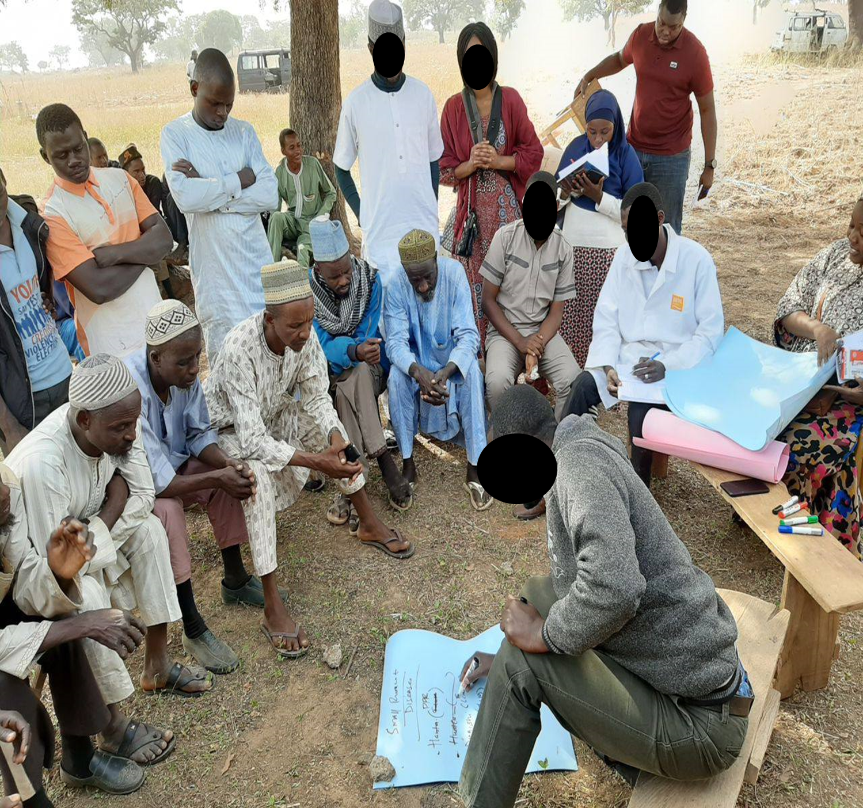



MODULE 5
SURVEY APPROACHES AND DESIGN IN DISEASE SURVEILLANCE

Slide 2
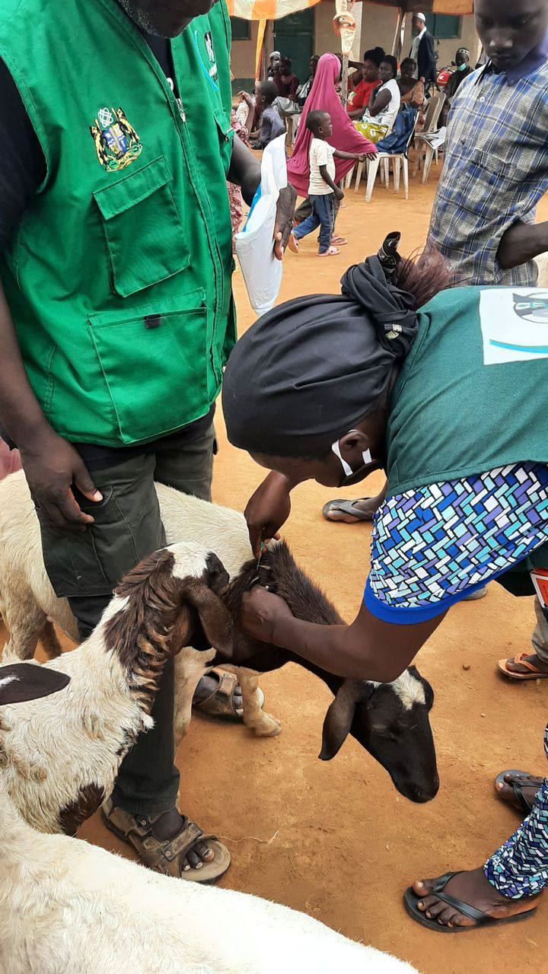

DISEASE SURVEILLANCE
Is an essential tool to detect disease or infection, Monitor disease trends (identify outbreaks)
Facilitate the control of disease or infection
Support claims for freedom from disease or infection (e.g. FMD free status, Polio free status)
Provide data for use in risk analysis, for animal and/or public health purposes, and
To substantiate the rationale for sanitary measures etc.

Slide 3
SURVEYs IN DISEASE SURVEILLANCE
Survey design: The target and study populations should first be clearly defined. Depending on the design of the Survey, appropriate sampling units should be defined for each stage
The design of the survey will depend on the knowledge of the size, structure and distribution of the population, the epidemiology of the infection or infestation and the resources available

Slide 4


RATIONALE FOR SURVEYS IN DISEASE SURVEILLANCE AND EARLY WARNING
Survey approaches aim at explaining the situation of disease. These include presence and patterns of occurrence (affected locations, numbers affected, consequences, seasonality, trends of incidence and others).
Specific objectives for a particular survey exercise vary depending on suspected disease, level of involvement (i.e the phase of emergency) and circumstances on ground.
The aim and objectives of a survey determines the methodology applied.

Slide 5

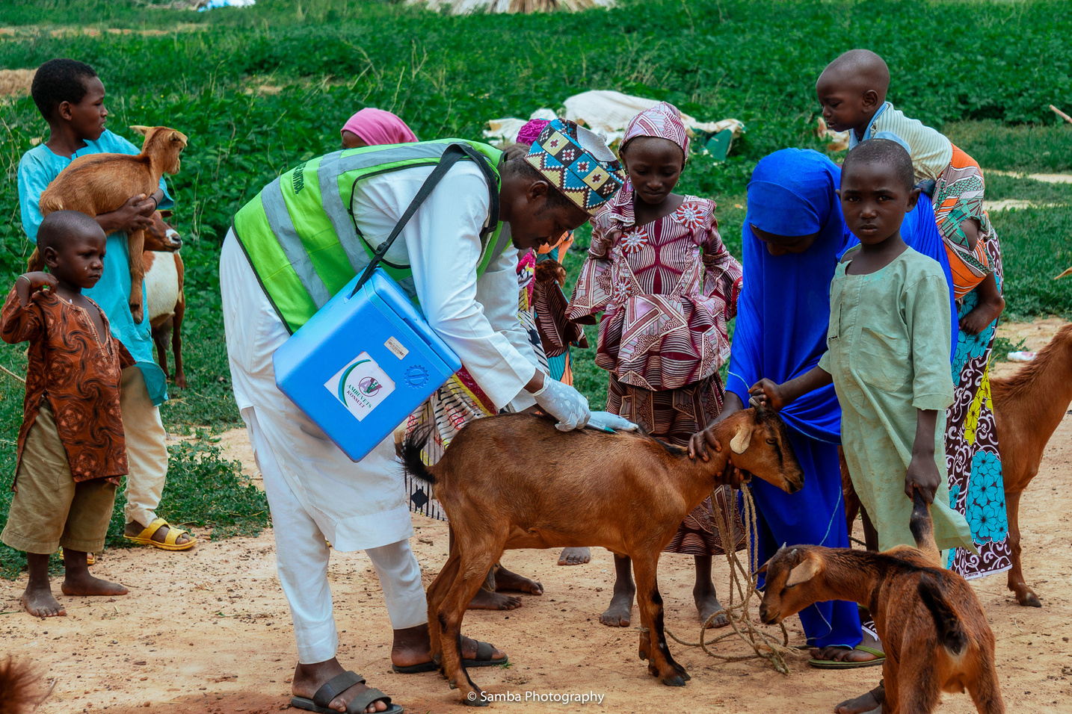
FACTORS TO BE CONSIDERED WHILE PLANNING THE METHODOLOGY/APPROACH
What questions does the survey seek to answer?
What information will the survey gather?
What information is already available?
What problems does the survey seek to solve?
What are the expected sources of information?
These could be livestock keepers, health institutions, government ministries, field data collectors and similar others.

Slide 6
ACCURACY AND RELIABILITY OF RESULTS OF A SURVEY
Use of combination of several methods and tools - In case of errors in some tools, other tools helps in verifying. When more than one method yields similar information, it implies the information is more accurate.
ii) Adequate coverage – Survey should cover adequate area, number of patients, locations, communities, in order to obtain a clear picture of the situation. This is usually considered in terms of sample size. The bigger the sample size, the more accurate the information. However, too large sample size consumes resources for no purpose.

Slide 7
ACCURACY AND RELIABILITY OF RESULTS OF A SURVEY CONT’D
iii) Relevant source – The source should be part of affected or very closely associated with those affected. Wrong source leads to wrong conclusions hence wrong response in mitigation actions.
iv) Several sets of data (Replication) – For instance when obtaining information by interview, they should be from several affected villages. The same type of interview/inquiry is repeated in a number of villages. In case in which the data is clinical sample, this is collected from a number of communities, different individuals.

Slide 8
METHODOLOGY AND TOOLS FOR SURVEYS IN DISEASE SURVEILLANCE AND EARLY WARNING
CHAIN OF REPORTING
(i) LITERATURE SEARCH/REVIEW
Sources of literature are reports from departments, Ministry of Health, Aid agencies, University papers, Assessment missions and similar others.
They give information on percentage affected, locations affected, time, mortality rate, spread, species of and clinical signs / symptoms.
They may be in form of hard copy papers in files or online in the internet.
Review of existing /literatures or reports

Slide 9
METHODOLOGY AND TOOLS FOR SURVEYS CONT’D
CHAIN OF REPORTING
(ii) FIELD VISITS
Field visits are usually important for household interviews, clinical and pathological samples, interview of key informants, community engagements
Direct observations are made during field visits.
Important field visits during animal disease investigations include visits to cattle camps, Animal farms, grazing areas, watering points, migration routes, live bird markets, abattoirs and slaughter slabs.

Slide 10
METHODOLOGY AND TOOLS FOR SURVEYS CONT’D
CHAIN OF REPORTING
(iii) KEY INFORMANT INTERVIEWING (KII)
Key informant interviews are necessary for obtaining information from key people (stakeholders) involved in livestock keeping.
Such key informants comprise:
owners of livestock, herders, milking women and girls, leaders, community chief, livestock traders, butchers, traders of hides and skins, milk vendors, milk transporters, staff of ministries, medical staff, CHEW, CAHW, staff of aid agencies, staff of inter-governmental organizations such as FAO, AU-IBAR, IGAD, laboratory staff,.

Slide 11
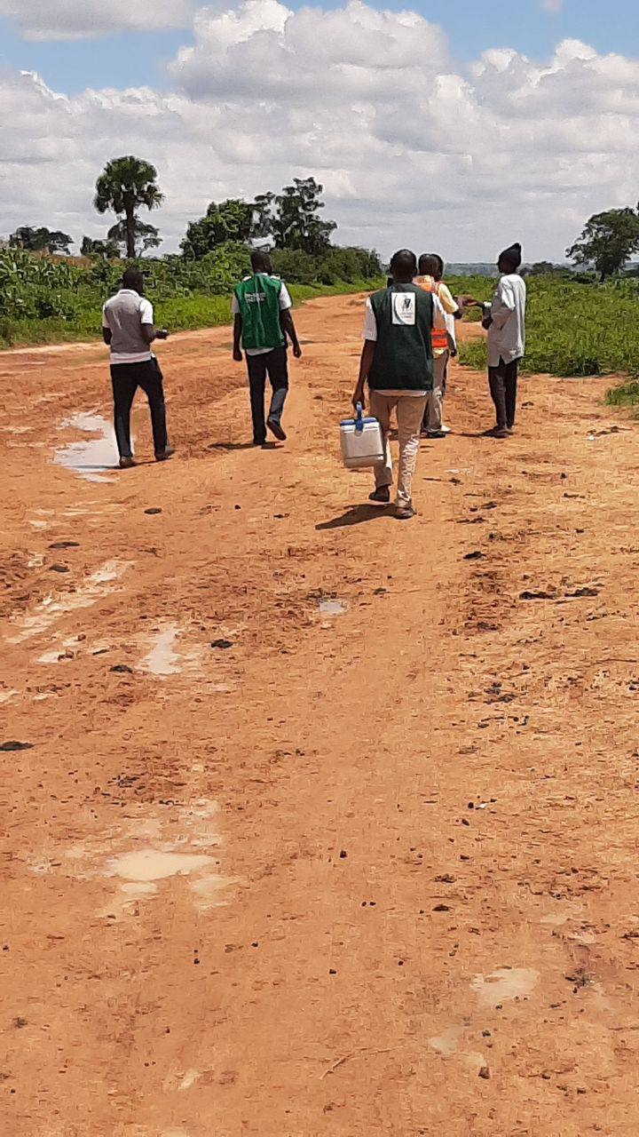
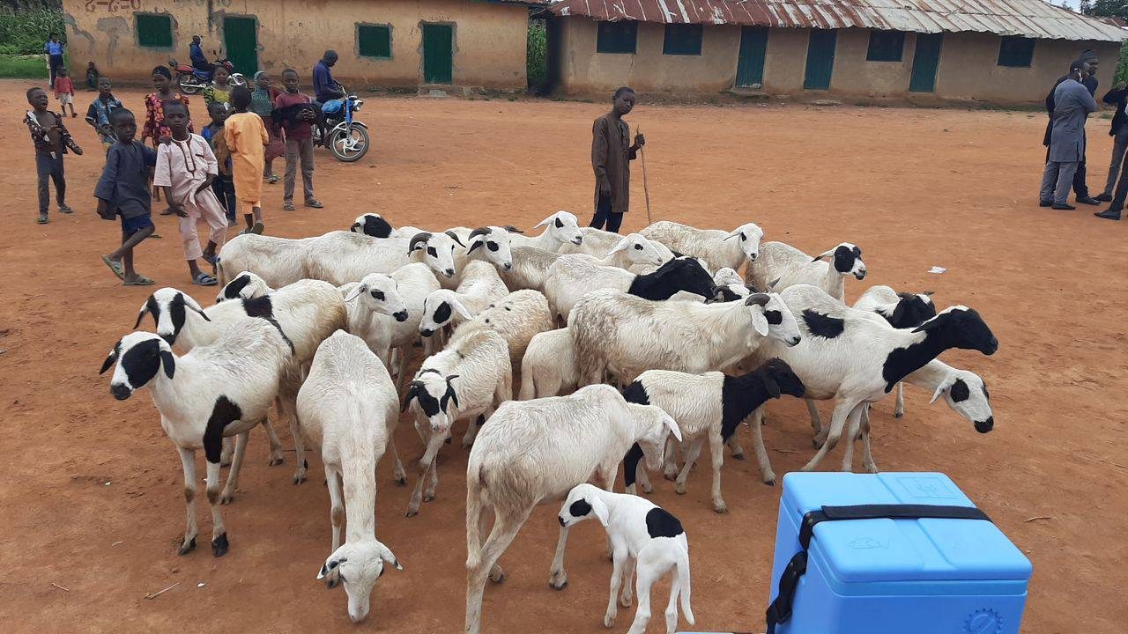
Field Visits by Survey Team

Slide 12
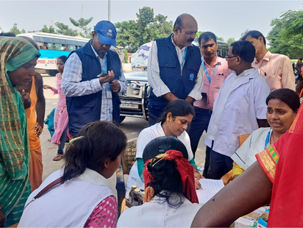
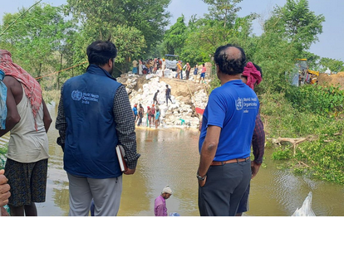
Field Visits by Survey Team

Slide 13
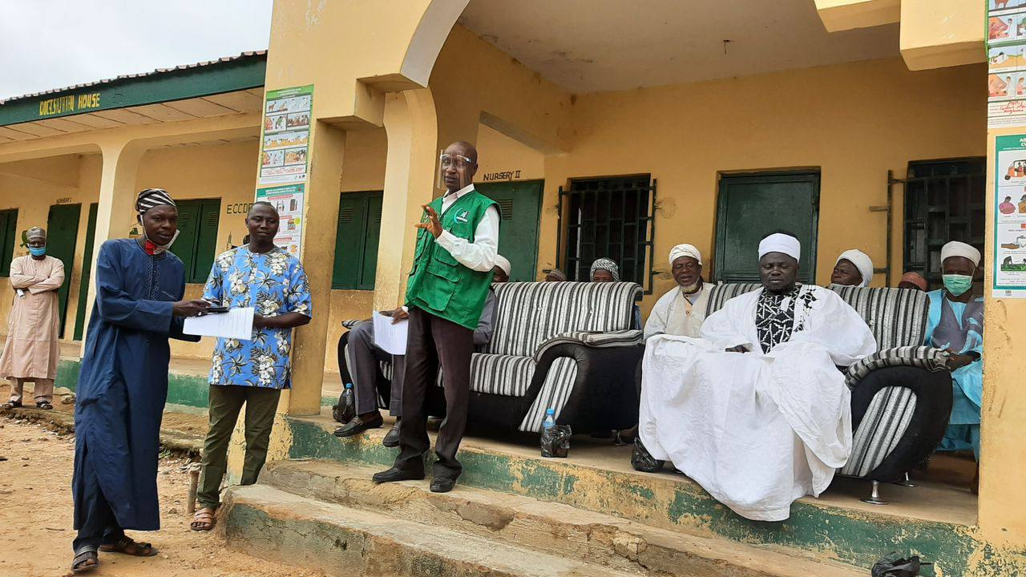
Key Informant Interviews

Slide 14
METHODOLOGY AND TOOLS FOR SURVEYS CONT’D
CHAIN OF REPORTING
(iv) HOUSEHOLD INTERVIEWS
Information and data specific to individual households.
Questionnaires are often applied to conduct household interviewing and administered by enumerators.
It is important that respondent household member clearly understands the question posed to them.
This requires that the enumerator also clearly understands the questions well and is able to convey it to the respondent accurately.
Questionnaires are also considered to be more extractive, only obtaining information from respondent while not giving feedback possibilities.

Slide 15
METHODOLOGY AND TOOLS FOR SURVEYS CONT’D
CHAIN OF REPORTING
(v) COMMUNITY DIALOGUES
Various sectors of the community are knowledgeable about information on diseases.
Community dialogues (CDs) are meetings with community members during which interactive discussions are conducted.
Various types of participatory tools are applied during interviews, such as:
Simple listing Proportional ranking
Pair-wise matrices Spatial mapping,
Livelihood resource mapping Historical timelines,
Seasonal calendars Institutional analysis

Slide 16
METHODOLOGY AND TOOLS FOR SURVEYS CONT’D
CHAIN OF REPORTING
(vi) COLLECTION OF CLINICAL AND PATHOLOGICAL SAMPLES
These include blood samples, swabs, fecal samples, skin scrapping, pus, intestinal contents, samples of feed/food, tissue parts such as the head of dead dog in cases of Rabies.
Critical precautions during sample collection;-
− Be careful to know circumstances under which blood, discharges, meat and tissues should never be touched. These include Suspected Anthrax, RVF and Ebola viral hemorrhagic fever (EHF).
− Blood samples could whole blood or sera.
− Special packaging and permits may be required to transport specific samples across particular borders.

Slide 17
METHODOLOGY AND TOOLS FOR SURVEYS CONT’D
(vii) PARTICIPATORY DISEASE SEARCH (PDS) AND PARTICIPATORY EPIDEMIOLOGY (PE)
Involving wider category of stakeholders increases the accuracy, validity and reliability of information and data.
This implies that various stakeholders are involved in providing relevant information and other data. Stakeholders should be involved throughout from planning, implementation of survey activities and in the responses.

Slide 18
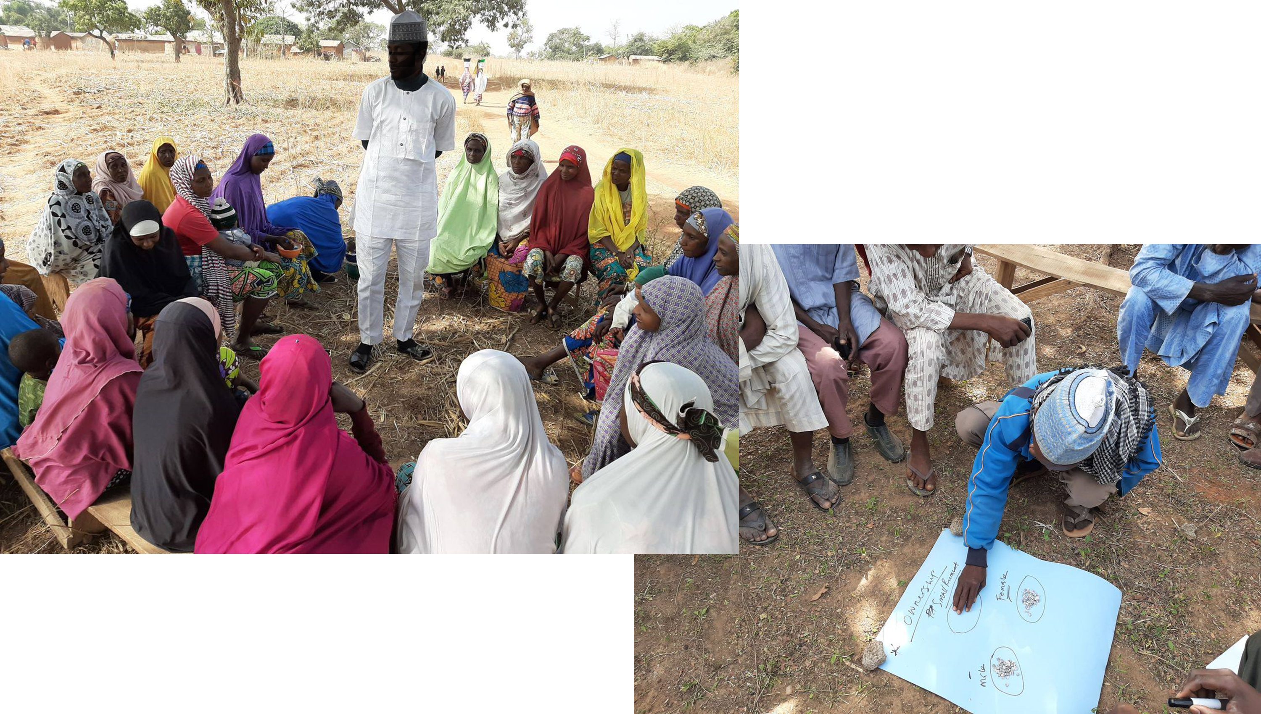
Participatory Disease search/Participatory Epidemiology

Slide 19
METHODOLOGY AND TOOLS FOR SURVEYS CONT’D
(vii) PARTICIPATORY DISEASE SEARCH (PDS) AND PARTICIPATORY EPIDEMIOLOGY (PE)
Effective disease survey comprise application of comprehensive methodology using diverse tools and approaches such as:
literature review,
field visits,
participatory rapid appraisal (PRA),
clinical and pathological samples collection and laboratory analysis
key informant interviews, household interviews,
statistical analysis,
Geographic information systems (GIS). .

Slide 20
METHODOLOGY AND TOOLS FOR SURVEYS CONT’D
CHAIN OF REPORTING
(viii) LABORATORY ANALYSIS
Laboratory analysis include:
  Bacteriological analysis
  Virological analysis
  Serological analysis
  Parasitological analysis
  Molecular analysis
  Haematology
  Histopathology
  Chemical pathology etc

Slide 21
METHODOLOGY AND TOOLS FOR SURVEYS CONT’D
CHAIN OF REPORTING
(ix) DATA ANALYSIS
Data analysis include statistical tests applied on figures collected from household questionnaires, figures obtained from observations of clinical samples, from laboratory results and on figures obtained from participatory tools.
Statistical parameters/summaries include mean, average, mode/most frequent, standard deviations, quartiles, bar chat, Piechad, histogram variance and others.
Depending on type of statistical summaries needed, various statistical software programs can be used including Ms Excel, SPSS, Genstat, SAS, and Harvey.

Slide 22

EXPERIENCE SHARING
REFLECT ON A TIME WHEN YOU WHERE INVOLVED IN ANY SURVEY RELATED TO DISEASE SURVEILLANCE
WHAT CAN YOU SHARE ABOUT THAT EXPERIENCE?
(LESSONS LEARNT..)

Slide 23



END OF MODULE 5

Slide 24


